Slide 1

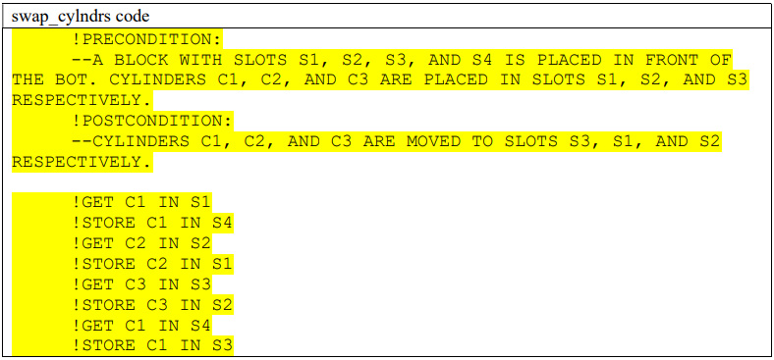
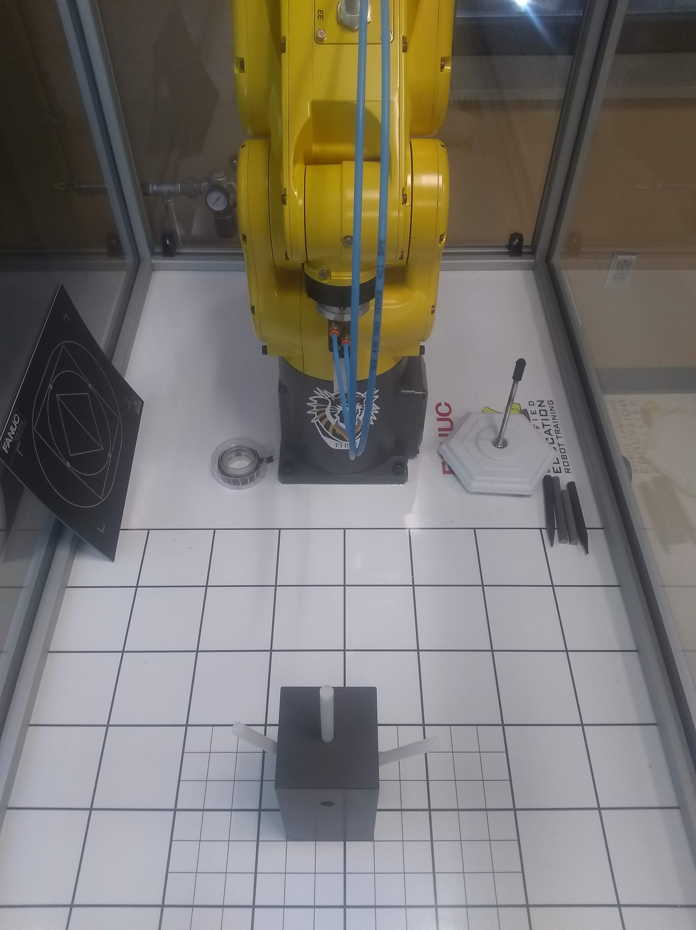
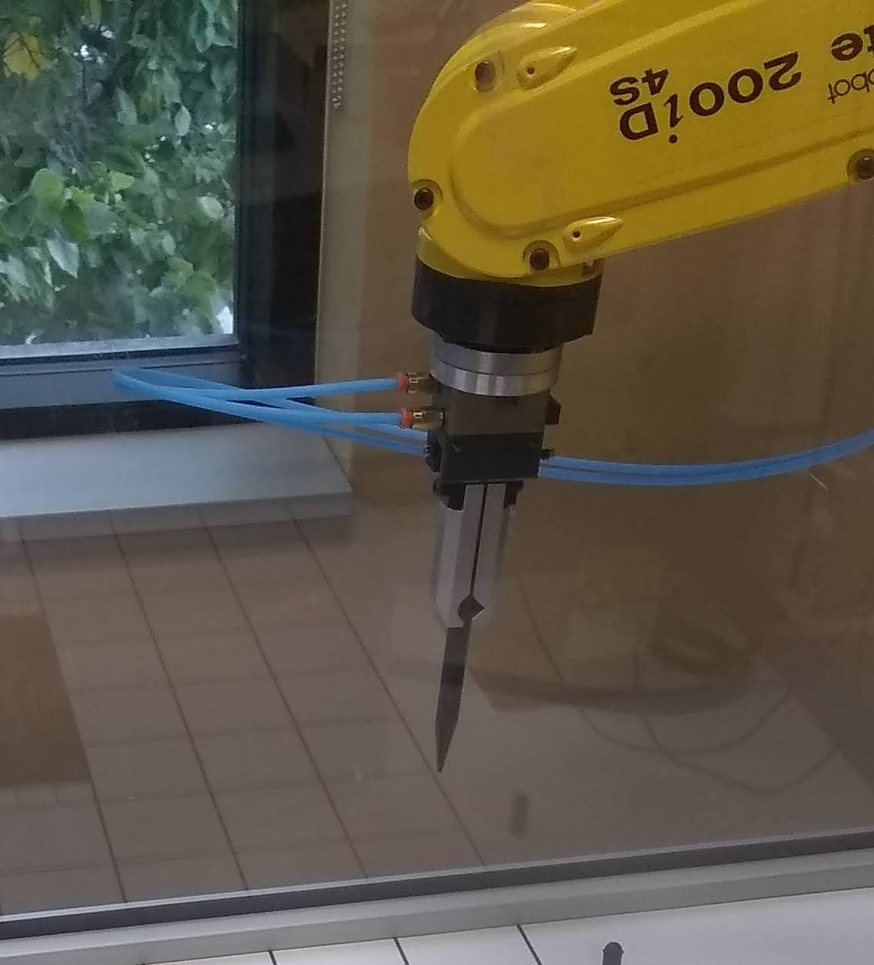
Wrangling Heavy Metal: Self-Education of Industrial Robot Programming (Case Study)
Research Student: Boyea, Matthew
Research Mentor: Chretien, Joseph
Department of Applied Technology, Fort Hays State University
Abstract
Methods
Findings & Conclusion
Modern manufacturing processes increasingly demand machine-driven solutions. When developing robot applications in industry, programmers must be able to safely write code which is reusable, expandable, and well-documented. This case study explores the following: Can an untrained student learn to develop programs for an industrial robot arm which meets industry criteria? What are the dangers of this kind of education process?
In 12.5 hours across a 1-month period, the research student studied chapters 6 to 15 within the provided programming manual and performed short lab procedures from the manual to develop an understanding of the robot. In 12.5 hours across the next 3 weeks, the student completed their first programming project which swapped the positions of cylinders with basic movement commands. During these processes, the student documented their process and designed procedures which would promote safe education and produce industry-acceptable code.
The student successfully educated himself within the guidelines provided by the research mentor. The student lamented at the end of the project that there were some flaws in the resulting program and some mistakes were made in the study. He reflects that the code would have to be refactored in many ways to be acceptable in industry. Regardless, the student developed a valuable education with a minimal time investment and produced documentation & procedures which may serve as valuable references during the education of other students.
This case study was designed to answer the following questions. Can an untrained student learn to develop programs for an industrial robot arm which meet industry criteria? What are the dangers of this kind of education process?
Materials required to emulate this research include:
Student laptop
FANUC America Corporation HandlingTool Operations & Programming Student Manual
FANUC LR Mate 200iD 4s Robot Arm
FANUC R-30iB Mate Controller
Block with 4 slots
3 cylinders
Twice per week (schedules permitting), the student came into the lab for 1 to 3 hours. The student was provided with the given materials and instructed to record their work hours, along with a short description of their progress. Once the student reported that they were “sufficiently comfortable” with the machine by reading the manual and practicing, they were assigned a project which was designed to imitate a common machine arm task known as “palletizing.” A block was placed in front of the machine arm in a fixed position. The block had four slots, three of which contained a cylinder. The student was told to write a program for the robot arm to swap the positions of the three cylinders without placing any of the cylinders on the ground. The definition of the problem, the constraints of the operation, and the procedure to come upon a solution were all to be specified before teaching the program to the FANUC machine. The student was tasked with designing a way to communicate this information in a proposal and have it reviewed by the research mentor to verify that it was acceptably documented and safe. Once the proposed solution was accepted, the student was permitted to implement the solution for the machine arm. Upon completing the implementation, the student was instructed to document their development procedure in a guide to be referenced during the development of future teaching material.
The research student took about 12.5 hours across 6 sessions in 29 days to become “sufficiently comfortable” with the machine. They took about 12.5 hours across 5 sessions in the next 22 days to design and complete the assigned project. They took about 19.5 hours across the next 32 days to document their development procedure in a paper.
The suggested procedure in the student’s proposal and development guide imitates that of application programming documentation, as their background of study was in Computer Science. From their development guide, “To design any engineering solution efficiently and effectively, it may help to begin by clarifying the problem. The definition of the problem, the constraints of the operation, and the procedure may all be specified before teaching the FANUC machine. […] The problem may be defined by a state of ‘precondition’ and a state of ‘postcondition.’ An algorithm may be defined as a series of actions which reach the postcondition state via interaction with items outlined by the precondition state. […] Together, the precondition, postcondition, and procedure may be referred to as the algorithm.” They show their project’s procedure in the remarks in their code.
The untrained student developed skills to write programs for a brand of industrial robot arm, provided only the manual, the internet, and a set of guidelines while adhering to the suggested guidelines. However, the resulting code was imprecise. In the demo, the machine could be seen pushing the block due to slight intolerances. Furthermore, the student reported 3 unintentional collisions between the robot and its enclosure during the study. The student reports that these issues were the result of naivety and time constraints.
Further research could task the student with more complicated projects or examine the efficacy of teaching materials produced by the student or examine how other students perform in this experiment. The student lamented that they believe education comes as a product of incentive to learn and the accessibility of information. They said that without one or the other, this experiment would have likely failed.
Introduction
Robot programmers are imperative to many manufacturing industries. Mike Cicco, president and CEO of FANUC America, has claimed that FANUC has sold over 750,000 robots globally_{[1]}, more than any other industrial robotics supplier in 2021. FANUC may be considered the largest industrial robot manufacturer in the world. It follows that skilled and innovative developers who are trained to work with FANUC tools are in demand. This case study aims to provide insight into the process of self-education in its real-life context to make robotics education more accessible.
The research student began this research project with an interest in the machine and without any robotics experience. The goal of the student was to complete a project while imitating manufacturing procedures and to become comfortable programming for the machine, while documenting his development process such that it could be repeated by other students. The student wrote a development procedure in the interest of teaching other students to safely write reusable, expandable, and well-documented code. Under the guidance of the research mentor, this procedure is meant to teach in an approachable way such that it may be more accessible to other students.
References
[1] - https://www.fanucamerica.com/news-resources/fanuc-america-press-releases/2021/07/01/global-automation-leader-fanuc-announces-production-of-750-000th-robot
Block with 3 cylinders under FANUC LR Mate 200iD 4s
FANUC LR Mate 200iD 4s end of arm tooling holding a graphite stick

